Slide 1
CM/AI Assist
AI in ConSol CM
November 2025, Product management ConSol CM

Slide 2




Dear ConSol customers,
We would like to take this opportunity to introduce our new CM/AI Assist add-on, which allows you to use LLMs directly from ConSol CM. Let AI assist you with routine tasks so that your employees can concentrate on what matters most. We have taken data protection into account from the outset: the Privacy Purger ensures that no personal data is sent to third parties.
Let requests from different LLMs be summarized and categorized.
Automatically recognize when a request contains multiple issues so that you can open multiple processes directly.
Save time by having LLMs pre-formulate responses.
Please contact us for further information or a live demo.
Your ConSol CM Product Management & Sales Team
Johanna Juszak
Engelbert Tomes
Florian Fiessmann
Kai Hinke

Slide 3
Advantages of CM/AI Assist
CM/AI Assist — the AI interface directly in the web client
Take advantage of the many possibilities offered by artificial intelligence to improve efficiency and quality
Fewer repetitive tasks leave you more time for the essentials
Improve the quality of customer communication with less effort
Provide your users with convenient, data protection-compliant access to LLMs. This eliminates the need to use AI via a browser and reduces the risk of accidentally sharing personal data.
Open completely new automation scenarios, e.g., through AI-supported recognition and handling of routine enquiries
In addition to the add-on, you only need an API token to access the AI. The specific use cases are implemented using the standard tools provided by ConSol CM
3

Slide 4
Data protection at CM/AI Assist
Data protection considered from the outset – with Privacy Purger
CM/AI Assist includes Privacy Purger, which removes personal data before sending it to the LLM.
This means that the function complies with data protection regulations and you don't have to worry about sensitive data belonging to your customers or employees falling into the wrong hands.
The text, e.g. a customer's email, is first cleaned up by the Privacy Purger. This replaces all personal data, such as names, email addresses, telephone numbers or account numbers, with variables.
After that it can then be sent to the LLM. For example, external parties only receive the variables that have replaced the customer or employee data.
4

Slide 5
Use cases for CM/AI Assist
Let AI support you in your daily work
Automatically detect whether a request contains multiple issues. If necessary, multiple processes can be created directly to separate the issues clearly.
Have replies to emails pre-formulated. This gives you beautifully worded texts in no time at all, which you only need to proofread briefly before sending.
Automatically generate a summary for internal documentation as soon as a process has been completed.
Automatically categorise your enquiries so that they are forwarded directly to the right team.
Recognise recurring routine enquiries and have them processed fully automatically by the workflow engine.
5

Slide 6
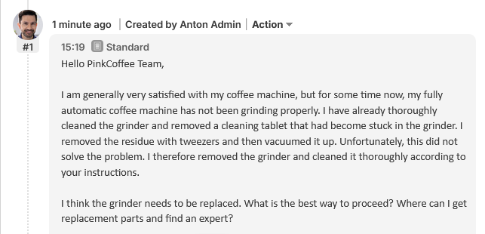
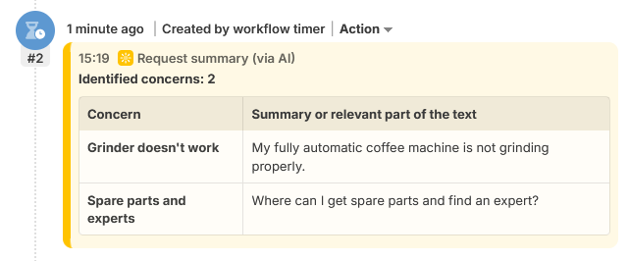
Application example for CM/AI Assist
Save valuable time: use the AI summary of emails instead of reading them in full.
Incoming E-Mail
Summary of concerns
6

Slide 7
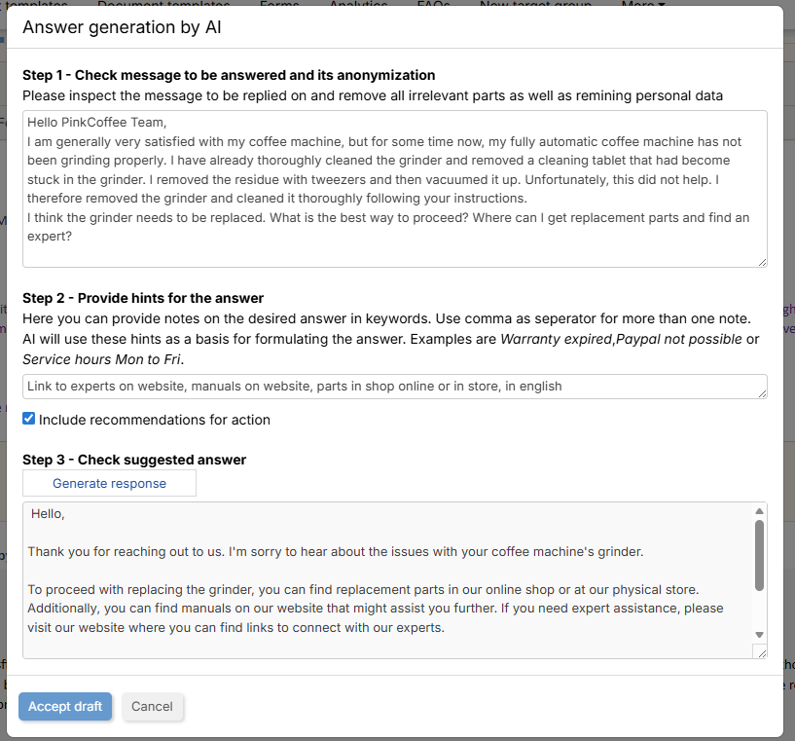
Application example for CM/AI Assist
No more searching for the right wording and goodbye spelling mistakes: suggested responses from LLMs
Source text cleaned up with Privacy Purger
Notes for the LLM on what the essence of the answer should be
Suggested reply received
7

Slide 8

See CM/AI Assist live in action
See the features presented here in action in our demo video.
https://www.youtube.com/watch?v=F-KeLSM9O3U
8

Slide 9
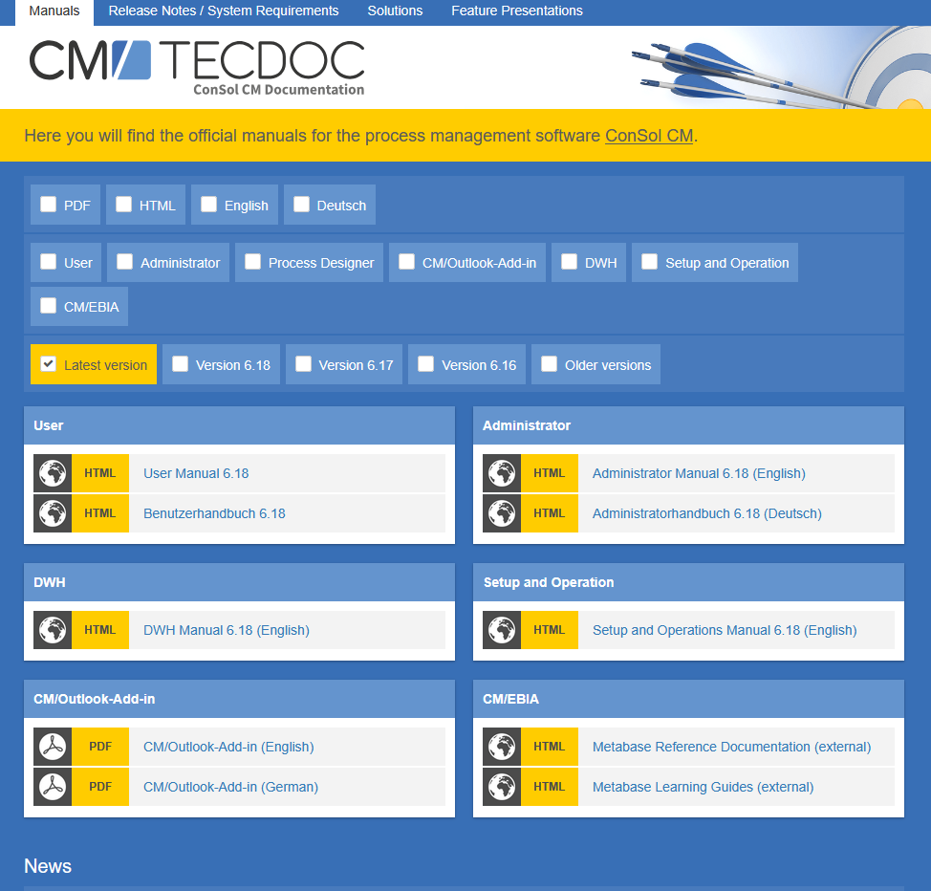
Would you like to learn more about ConSol CM? Please use our TecDoc server
There you will find:
Manuals
Administrator
User
Release Notes
System Requirements
Feature Presentations
Solutions
We hope you enjoy the new version of ConSol CM!

