Slide 1
AI Features in ConSol CM
November 2025, Product Management ConSol CM

Slide 2




Dear ConSol CM Customers,
We´re excited to present the integrated AI functions in ConSol CM. By embedding modern language models (LLMs) directly into the system, we enable smart automation – with no need for workarounds or external tools.
Your benefits at a glance:
Less manual effort, more focus on what truly matters
Instant insights thanks to automatic process summaries
Flexible configuration directly within the Web Admin Suite
These features can be seamlessly integrated into existing workflows, significantly reducing your daily workload.
If you have any questions or would like to see a live demo, feel free to reach out!
Your ConSol CM Product Management & Sales Team
Johanna Juszak
Engelbert Tomes
Florian Fiessmann
Kai Hinke

Slide 3
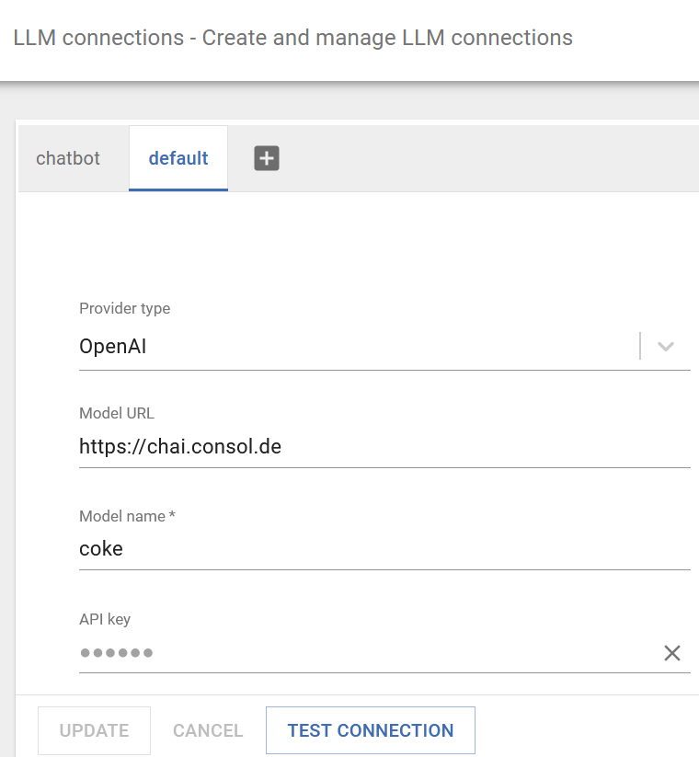
Set up LLM connections
Basic requirement for all AI features
All AI features in ConSol CM rely on a connected language model (LLM). This connection is configured centrally in the Web Admin Suite.
Here's how to set it up:
Open the ‘LLM Connections’ page in the Web Admin Suite.
Create a new connection or edit the default connection.
Select the type of provider, e.g. OpenAI, Ollama or Azure.
Enter the API URL and the access data for your LLM service.
Decide whether to use the Privacy Purger.
Test and save the connection.
3

Slide 4
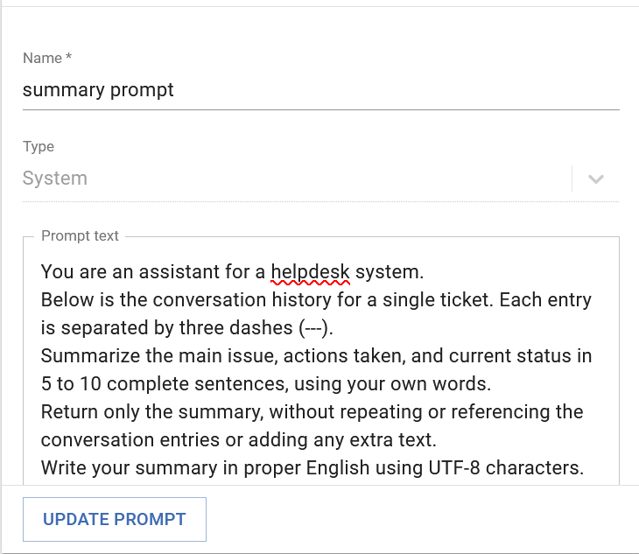
Manage prompts in the Web Admin Suite
Context control for your AI features
Prompts are key text inputs that guide the behavior of an LLM and define what it should do. In ConSol CM, prompts can be managed and customized directly within the Web Admin Suite.
Here’s how it works:
Prompts for standard features are automatically created as system prompts (e.g. translation prompt, summary prompt).
On the “Prompts” page in the Web Admin Suite, you can:
Edit system prompts and tailor their content to your needs
Create your own custom prompts
Use the prompt wizard if you're unsure how to phrase a prompt. The wizard guides you through the process step by step, making it easy to create effective prompts – even without expert knowledge.
4

Slide 5

Enable standard AI functions in ConSol CM
Smart support – no add-ons required
ConSol CM offers AI functions as standard that are easy to activate and configure—directly in the Web Admin Suite.
Automatic translation of field names and portal texts
Summary of process communication
How to activate these features:
Set up the LLM connection → via the “LLM connections” page
Configure the system properties → via the “System properties” page where you enter the LLM connection name, prompt, and provider type in the properties starting with “translationService” and “summaryService”
Customize the prompts (optional) → via the “Prompts” page
To use these features, you need your own API access to an LLM or to DeepL.
5

Slide 6
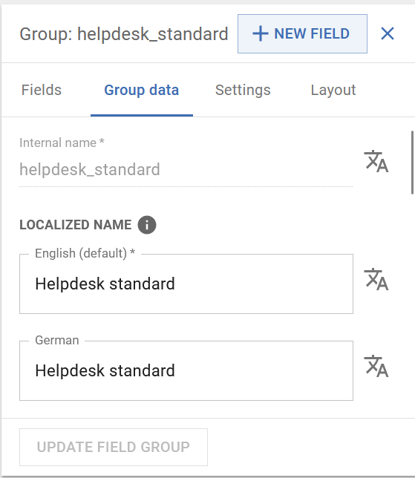
Use automatic translation in WAS
Simplify localization – directly in the admin interface
The automatic translation feature in the Web Admin Suite allows you to translate content into multiple languages quickly and consistently – with no manual effort required.
Where you can use it:
Internal name: Automatically generates user-friendly field names (only when using an LLM)
Localized name: Translates field names into all configured languages
“Files” tab in portal configuration: Translates complete JSON files (e.g. localization.json, components_localization.json) into the desired target languages
Tips for best results:
Using English as the source language usually delivers the highest quality translations. DeepL is generally faster, while LLMs offer greater flexibility. You can also trigger automatic translation within workflows via the API method translationService.translate
6

Slide 7
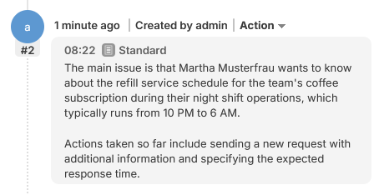
Use AI to summarize cases in the workflow
Quick overview thanks to automatic summary
With this feature, ConSol CM automatically generates a compact summary of all case communication using an LLM – simply within a workflow activity.
Your benefits:
Fast understanding of long or complex cases
Ideal for onboarding, training, and team handovers
How to activate this feature:
Decide when the activity should be available in the workflow – always, or at a specific step
Use the function ticketService.summarizeTicket in your workflow script. You can choose to summarize all communication or only entries with a specific text class. The summary can also be written directly into the case for easy reference
7

Slide 8
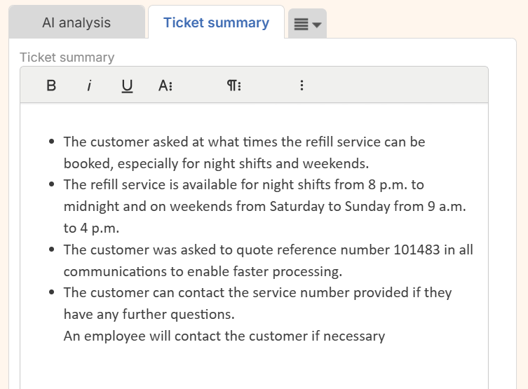
From standard functions to CM/AI Assist
More convenience, more automation – directly in the Web Client
ConSol CM already includes smart features like automatic translation and case summaries out of the box. For even greater efficiency in your daily business, the CM/AI Assist add-on offers extended functionality.
What CM/AI Assist adds:
Data protection-compliant processing with the Privacy Purger
Ready-to-use solutions for real-world use cases, such as:
Suggested replies to incoming inquiries
Detection of multiple requests within a single message
Automatic case categorization
Summary of lengthy emails
Recognition of routine inquiries with automated responses
The standard implementation can, of course, be customized to meet your specific requirements.
8

Slide 9
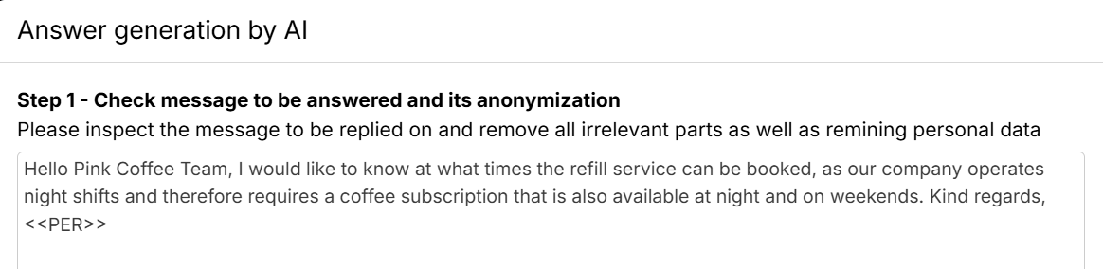
Data protection by design with the Privacy Purger
Your information stays protected
Privacy Purger is part of CM/AI Assist and ensures that all personal data is automatically removed or replaced before any content is sent to an LLM.
How it works:
Names, email addresses, phone numbers, and other personal data are replaced with placeholders
Only then is the content transferred to the LLM
The original data remains securely stored in the system
The advantage: You can harness the power of AI without compromising data protection – fully compliant with GDPR requirements.
9

Slide 10
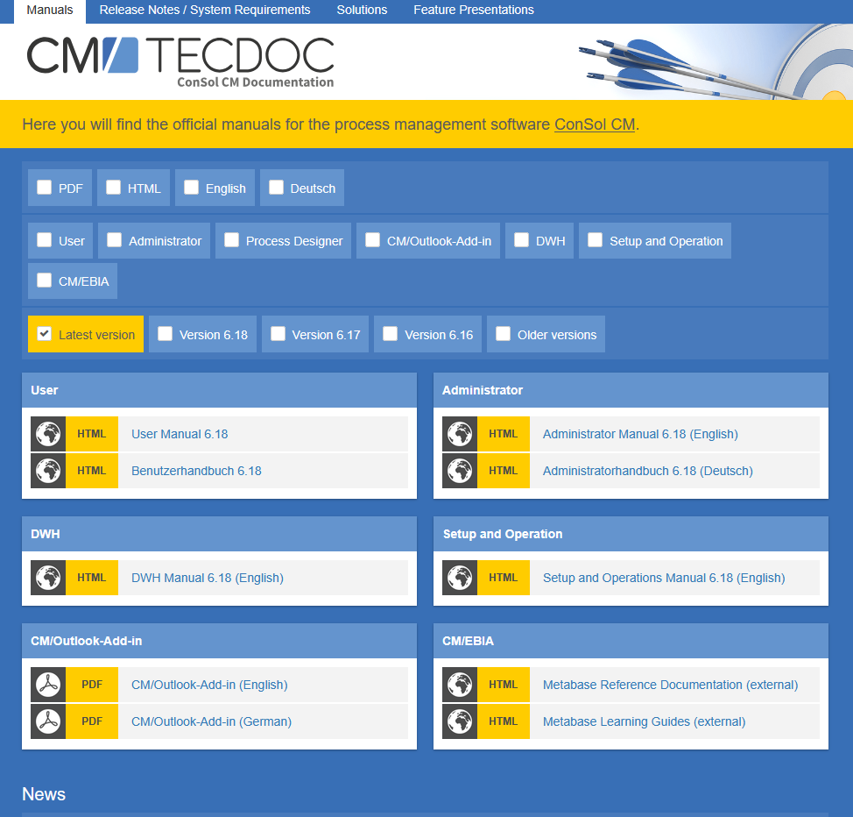
Would you like to learn more about ConSol CM? Please use our TecDoc server
There you will find:
Manuals
Administrator
User
Release Notes
System Requirements
Feature presentations
Solutions
We hope you enjoy the new version of ConSol CM!

