Slide 1
CM/Archive
December 2022, Product management ConSol CM

Slide 2




Dear ConSol customers, dear ConSol CM customers,
We would like to present you CM/Archive, a new ConSol CM add-on.
CM/Archive provides the possibility to permanently store cases outside the ConSol CM database:
Reduce the size of the ConSol CM database and the related costs.
Keep the cases to comply with legal requirements and for future reference.
We hope that you enjoy reading this presentation and discovering CM/Archive.
Please contact us to see a live demo. We are happy to help you with questions about your ConSol CM system.
Your ConSol CM Product management & Sales team
Jan
Zahalka
Engelbert
Tomes
Florian
Fiessmann
Kai
Hinke

Slide 3
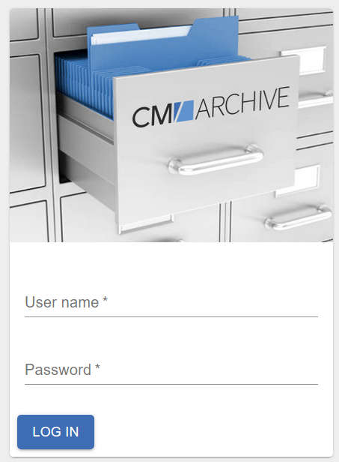
CM/Archive overview
Advantages
Features

Slide 4
Advantages of CM/Archive
Save old cases in CM/Archive instead of the production database
Free space on the production database
Reduce the costs for database storage
Reduce the load on your production database and improve the overall system performance
Keep all cases in in CM/Archive to comply with legal requirements
Access the cases in CM/Archive to use them as a reference
If the Web Client should always be the first place to go:
Keep the basic case data in the Web Client and archive the case history.
4

Slide 5
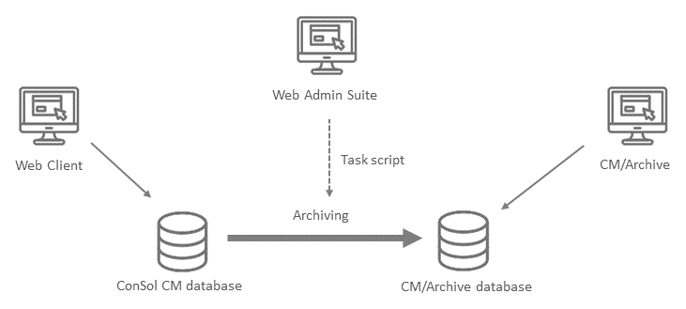
Features of CM/Archive
Operating principle of CM/Archive
Archiving is done using a task in the Web Admin Suite
Access to the current cases using the Web Client
Access to the old cases using CM/Archive
Data of the case contact is also available in CM/Archive
5

Slide 6
Features of CM/Archive
Maximum flexibility for determining the archiving scope
You can freely determine the scope of archiving to match your business requirements:
Which cases should be archived? This can be decided based on criteria.
Should the archived cases by completely deleted from the Web Client?
Which parts of the case history should be deleted (everything, only attachments, only history entries)?
Should the cases remain in the DWH?
Example:
We want to archive all cases which were closed more than 5 years ago. The cases should not be removed from the Web Client, because our users always look there first. Therefore, we remove the case history to free space on the production database. The cases are not needed in the DWH anymore.
6

Slide 7
Features of CM/Archive
Remove case data from the production database
There are several options:
Completely remove the cases
  The cases cannot be found in the Web Client anymore.
Keep basic case data
  The basic case data is kept in the Web Client. Only the case history is deleted. The cases can still be found in the Web Client using search features.
Keep cases in the DWH
  The cases can be kept in the DWH if long-term reports are needed.
7

Slide 8
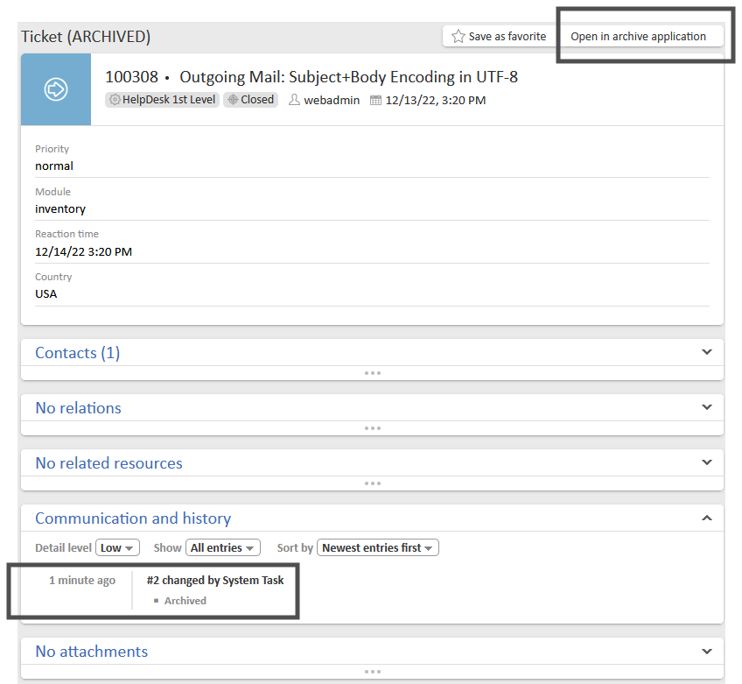
Features of CM/Archive
View partially archived cases in the
Web Client
The cases can be found in the quick and detail search.
The case data (fields, contacts, relations, etc.) is still available.
The case history was removed. You can configure which kind of history entries should be deleted.
There is a link to open the case in CM/Archive.
The case history contains an entry that the case was archived.
8

Slide 9

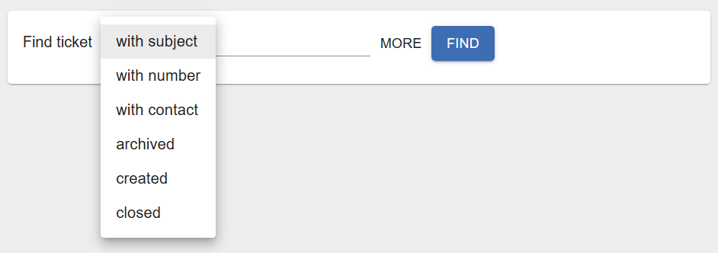
Features of CM/Archive
View archived cases in CM/Archive
CM/Archive offers a number of features for the archived cases:
Search for archived cases with different criteria
View an archived case, including its contact data
Create a PDF from an archived case
Delete a case from the archive
View archiving statistics
All cases in the archive are read-only and cannot be modified.
9

Slide 10
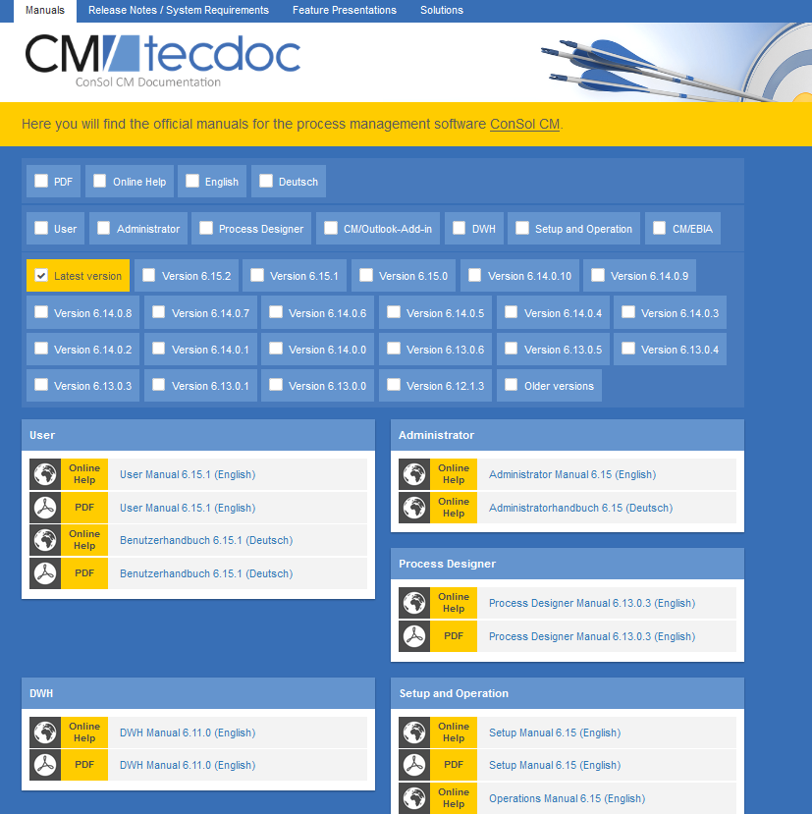
You want to learn more about ConSol CM?
Visit our TecDoc server
You can find:
Manuals
  Administrator
  User
Release Notes
System Requirements
Feature presentations
Solutions
Discover the new ConSol CM version!

