Slide 1
Business Intelligence with ConSol CM
Reporting for your business processes
December 2022, Product management ConSol CM

Slide 2




Dear ConSol customers, dear ConSol CM customers,
We would like to present you the business intelligence features of ConSol CM. Business intelligence allows you to analyze and show the data which is generated during the daily operation of ConSol CM. The created reports help you to gain insights and optimize your business processes.
ConSol CM includes several components for bringing business intelligence to life:
Dashboards in the Web Client (standard component)
Data warehouse (standard component)
CM/EBIA (add-on, since version 6.13.0)
Please contact us for further information or a live demo.
Your ConSol CM Product management & Sales team
Jan Zahalka
Engelbert Tomes
Florian Fiessmann
Kai Hinke

Slide 3
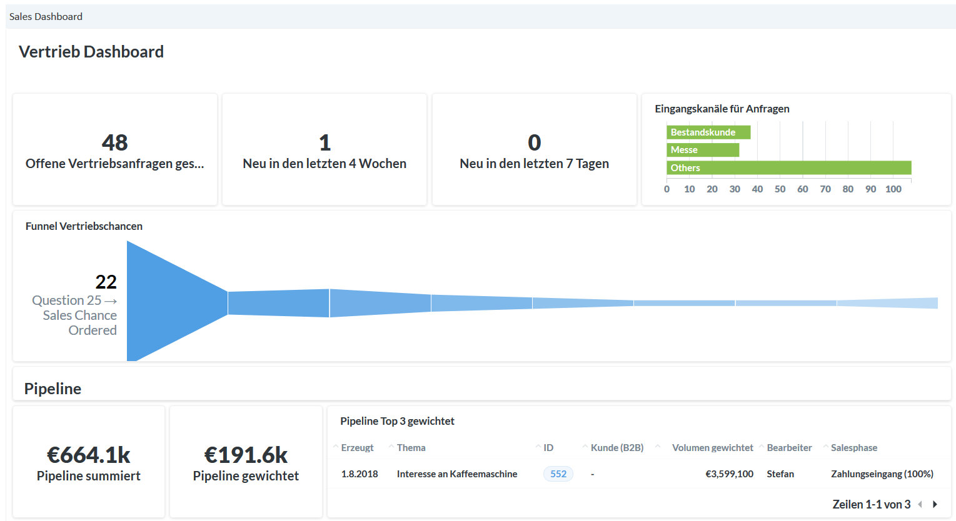
BI components
Dashboards
DWH
CM/EBIA

Slide 4
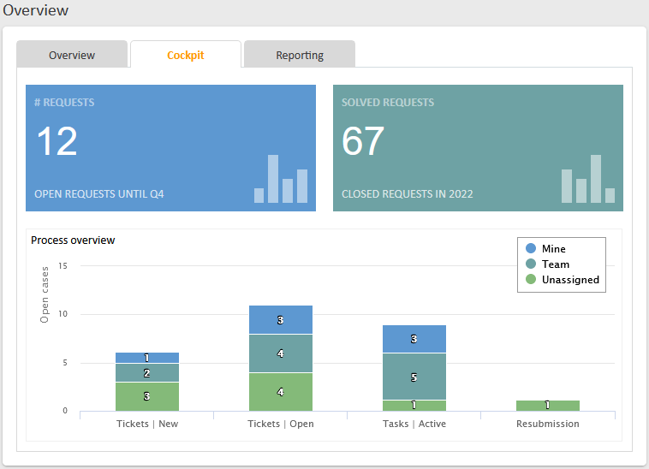
Dashboards
Show the most important information directly on the start page
Dashboards allow to visualize the data from the ConSol CM database.
Create a specific dashboard for every team. This gives the users an overview of the most important information for their team.
In addition to team-specific information, dashboards can also include personalized items for each user.
The data on the dashboard is automatically refreshed when the start page or tab is opened.
4

Slide 5
Dashboards
Take advantage of extensive design options using widgets
You can distribute the dashboard on several tabs for optimal clarity.
Various widgets types make dashboard design easy:
Charts
Tables
KPIs
News
Calendars
Recent changes
Recently visited pages
The data to be displayed is determined by script or configuration, depending on the widget type. In addition, you can include any desired HTML content and JavaScript in a dashboard.
5

Slide 6
Data Warehouse
Consolidate your data in the data warehouse (DWH)
The DWH uses its own database with an optimized data model, tailored specifically for reporting requirements.
You can execute complex queries on the DWH without impairing the performance of the production database.
Transfer data which is relevant for reporting automatically from the production database to the data warehouse database. You decide the data to be transferred in the data model configuration in the Web Admin Suite.
If your company already uses a business intelligence solution, you can use this application for reporting with the ConSol CM DWH. Alternatively, ConSol CM provides the integrated add-on CM/EBIA, which allows you to create and display reports in the Web Client in a convenient way.
6

Slide 7
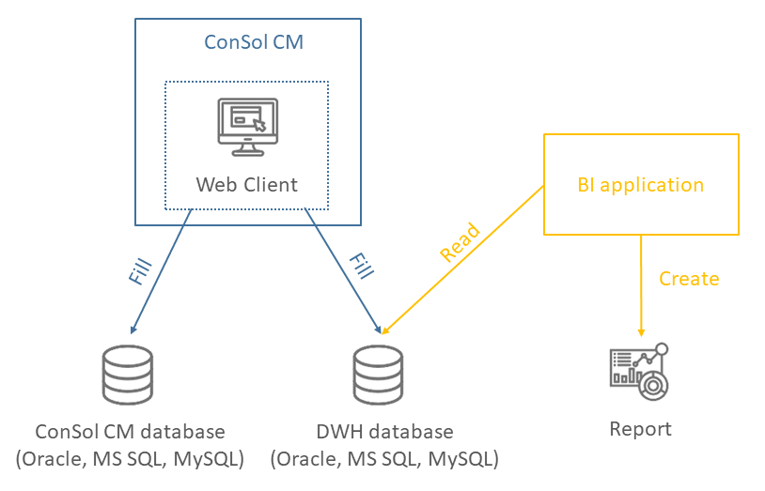
Data Warehouse
System architecture with data warehouse
7

Slide 8
CM/EBIA
Create your reports conveniently in the Web Client
CM/EBIA is fully integrated in the Web Client via single sign-on, both for report creation and for displaying the finished dashboards. A separate login is not required.
Create new reports and dashboards on your own. Self-service allows you do react quickly without having to rely on experts from other teams.
The graphical user interface of the CM/EBIA administration facilitates report creation, so that you can gain insights from your data without needing solid SQL knowledge.
CM/EBIA itself comes with an own role model which allows to implement separate access limitations. It is possible, for example, that the users can only see the data of their own teams, e.g. Sales, Service, Support, IT.
Let CM/EBIA send you specific analyses in regular intervals and never miss a trend in your data.
8

Slide 9
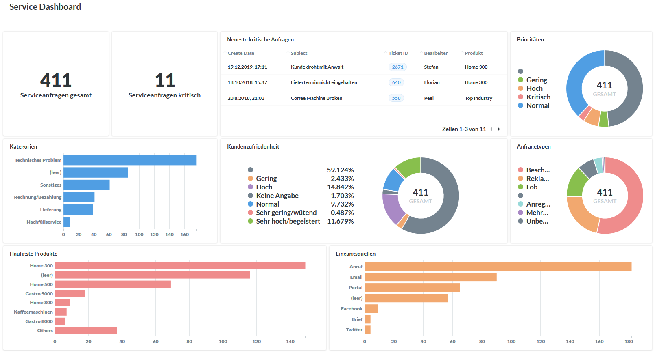
CM/EBIA
Publish dashboards directly in the Web Client
Create dashboards containing several reports.
You can place the CM/EBIA dashboards as widgets on the start page of ConSol CM.
This gives the users an overview of the most important insights for their daily work.
The data is refreshed automatically when loading the page.
9

Slide 10
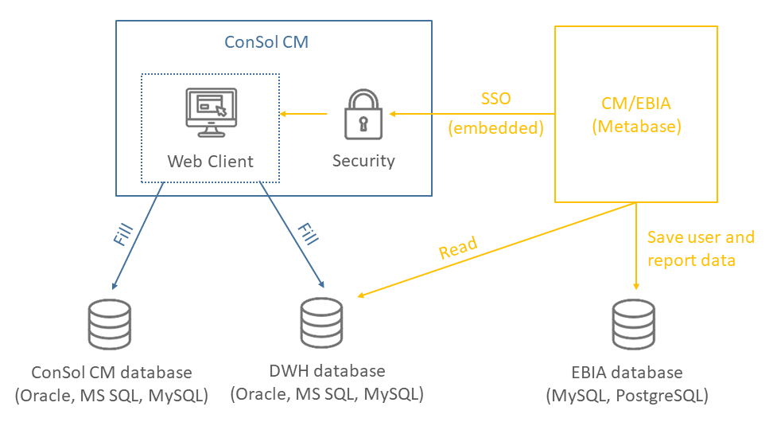
CM/EBIA
Architecture of CM/EBIA
10

Slide 11
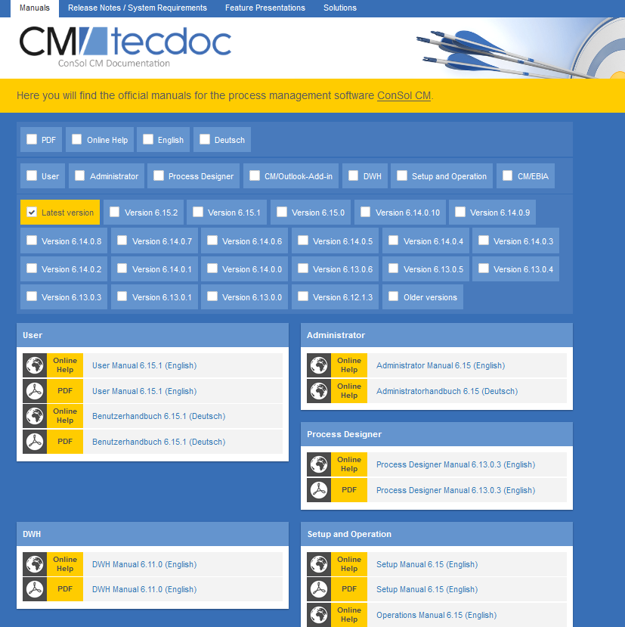
You want to learn more about ConSol CM?
Visit our TecDoc server
You can find:
Manuals
Administrator
User
Release Notes
System Requirements
Feature presentations
Solutions
Discover the new ConSol CM version!

