Slide 1
ConSol CM/Forms
November 2025, Product management ConSol CM

Slide 2




Dear ConSol customers, dear ConSol CM customers,
We would like to present you the web forms for ConSol CM.
Web forms can be filled out by users who have not logged in. They allow you to offer additional functionality with ConSol CM:
Registration forms
Customer surveys
Wizards for case creation
We hope that you enjoy reading this presentation and discovering web forms.
Please contact us to see a live demo. We are happy to help you with questions about your ConSol CM system.
Your ConSol CM Product management & Sales team
Johanna Juszak
Engelbert Tomes
Florian Fiessmann
Kai Hinke

Slide 3
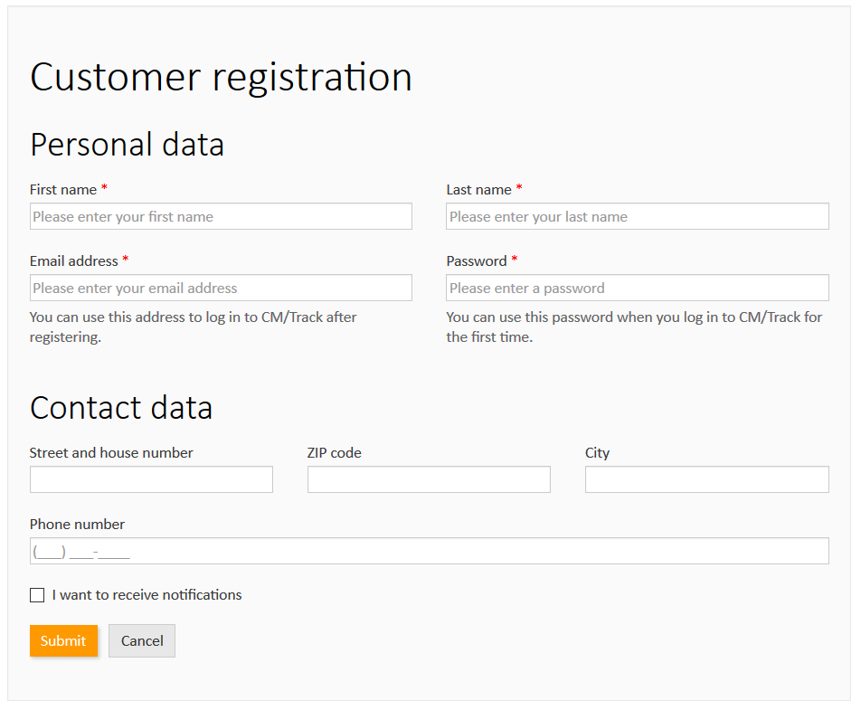
Web forms
Advantages
Use cases and examples
Creating a web form

Slide 4
Advantages of web forms
Extend your ConSol CM system with web forms
Easily create forms and provide additional facilities for working with ConSol CM to your users, customers and partners.
Increase the satisfaction of all stakeholders.
Collect valuable data, as customer feedback, to optimize your services.
Save implementation costs by using our comprehensive integrated form management features.
Create new web forms within minutes.
Reduce the workload of your users while offering a better service.
4

Slide 5
Use case examples for web forms
Web forms can be used in numerous situations
Registration forms Allow your customers to self-register in CM/Track.
Feedback forms Collect feedback and link it directly to a case.
Application forms Provide a convenient way for the candidates to send a job application and upload their CV.
Wizards for case creation Offer a wizard which guides the users through the case creation process.
5

Slide 6
Use case examples for web forms
Example 1 – Self-registration form
Create a simple registration form for customers to register in CM/Track.
The users do not have to spend time for data entry anymore. Instead, they just need to verify the data which the customers provided by themselves.
You can automatically assign the correct CM/Track user profile, so the customers can log in to CM/Track directly after submitting the form.
6

Slide 7
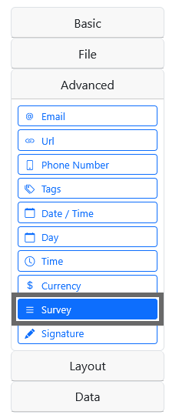
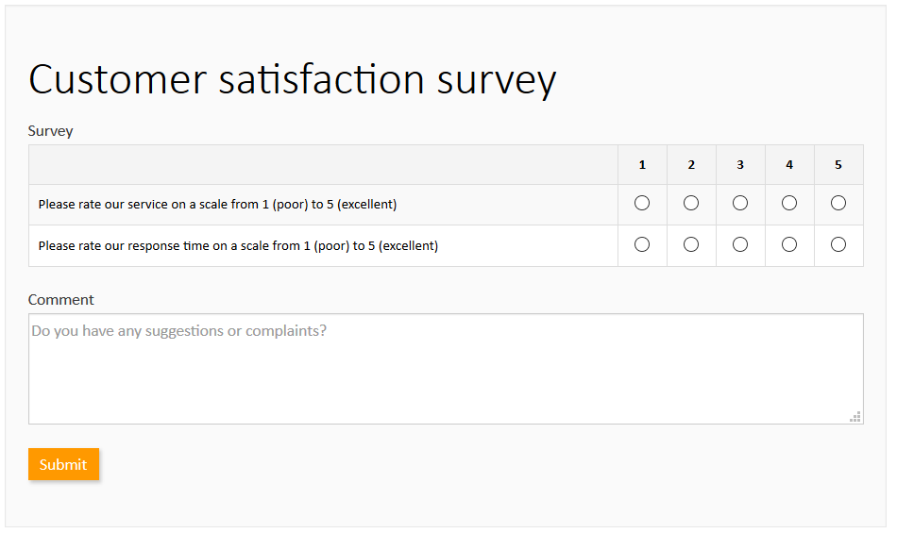
Use case examples for web forms
Example 2 – Form for customer feedback
Collect feedback from the customers by sending them a link to a customer survey. You can create the survey with a few clicks by using the Survey component.
7

Slide 8
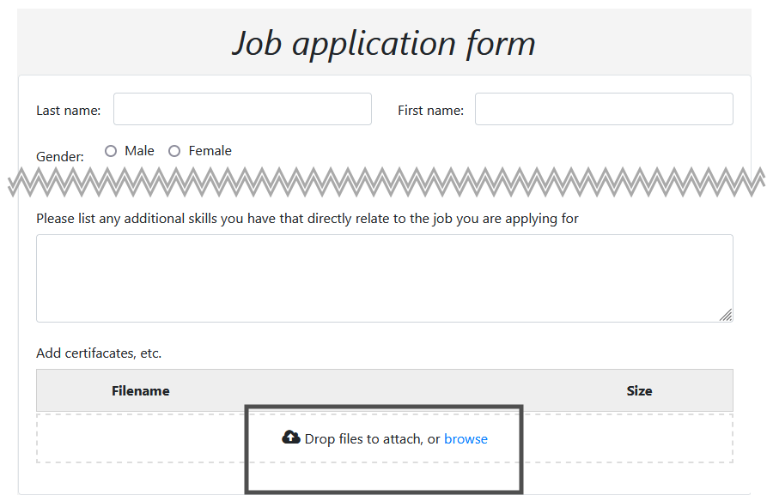
Use case examples for web forms
Example 3 – Application form
Publish an application form where the candidates can enter their data and upload their CVs.
The received job applications are linked to the job posting, so it is easy to track the applications.
8

Slide 9
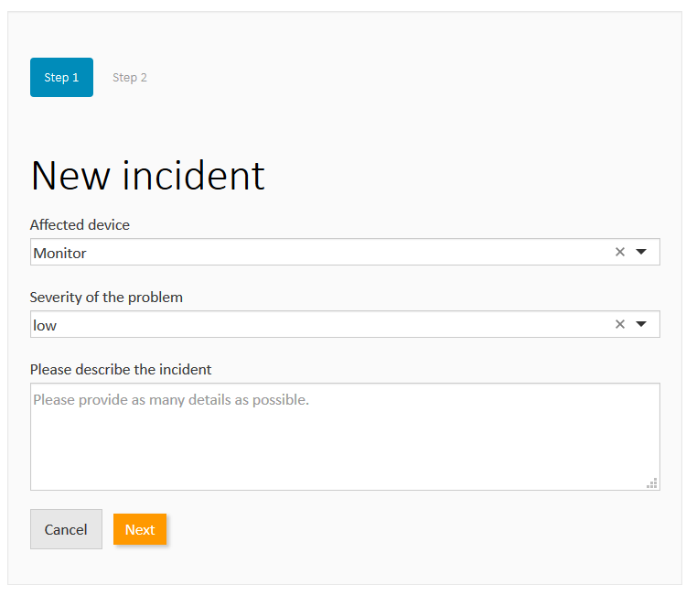
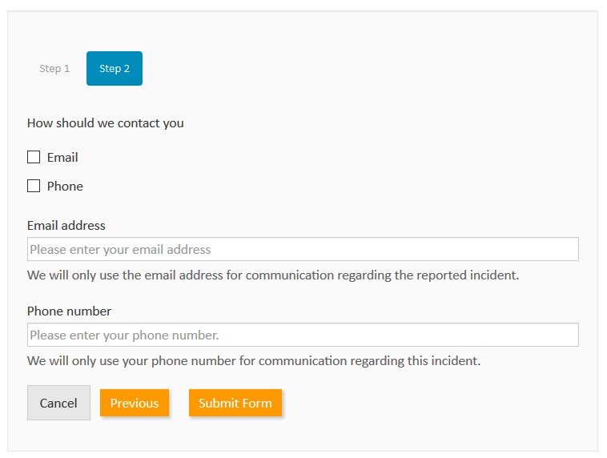
Use case examples for web forms
Example 4 – Wizard for case creation
Guide the user through the creation of a case using a wizard. A wizard can consist of several pages which helps to structure the content.
9

Slide 10
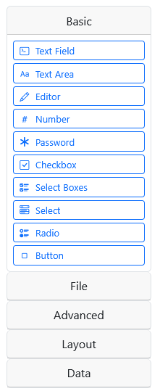
Creating a web form
Maximum flexibility when creating a web form
You can make numerous choices when creating a web form in the Web Admin Suite:
Publishing On the ConSol CM instance ↔ on an own instance
Data processing Direct processing of the submitted data ↔ saving data in the database for batch processing at a later point in time
Logic The logic for processing the data can be customized completely in the integration script
Form components Numerous form components, as input fields for different data types, selection fields, layout, buttons, file upload, extendable lists and tables
10

Slide 11
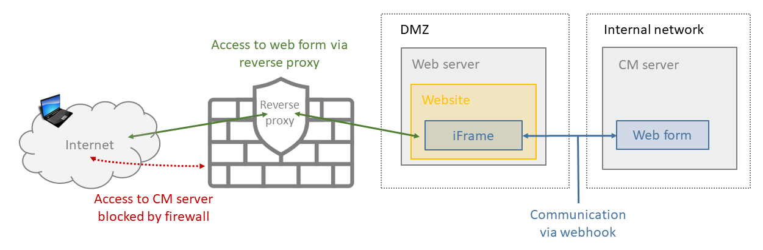
Creating a web form
Publishing a web form
There are two general options for publishing web forms:
On the ConSol CM instance:
Access via URL in the CM domain
Access via iFrame embedded in an external website
In a custom-build application
Example:
Usage as iFrame from the ConSol CM instance, external access allowed
11

Slide 12
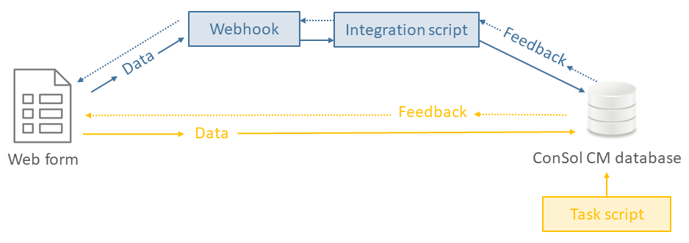
Creating a web form
Data processing
There are two options for processing the form data:
Using a webhook
The data is sent to ConSol CM via webhook.
The related integration script processes the data.
Using the database
The data is stored in the ConSol CM database.
The data is processed subsequently, for example by a task script executed in regular intervals.
Schematic visualization of data processing
Important: With variant b (database), feedback means that the data has been saved successfully. The web form is not notified about the result of data processing in the task script!
12

Slide 13
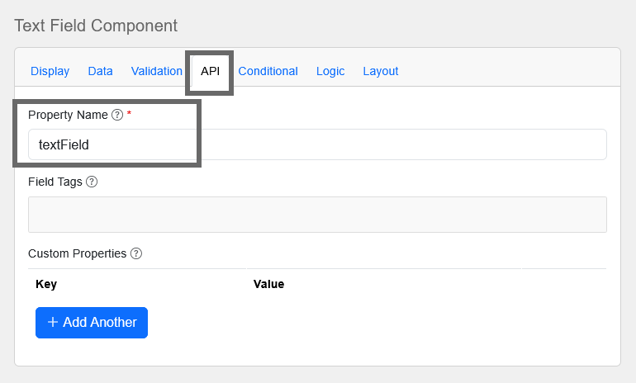
Creating a web form
Implementation of the script logic
The data entered in the web form is transferred to ConSol CM in JSON format.
The data can be easily retrieved in the script:
When creating the web form, you give a unique name to each field in the API tab.
The script analyzes the JSON. The fields with their values belong to the “data” object.
The ConSol CM API allows you to perform any desired action with the values, e.g. create a case or contact with the values, or update the values in an existing case.
13

Slide 14
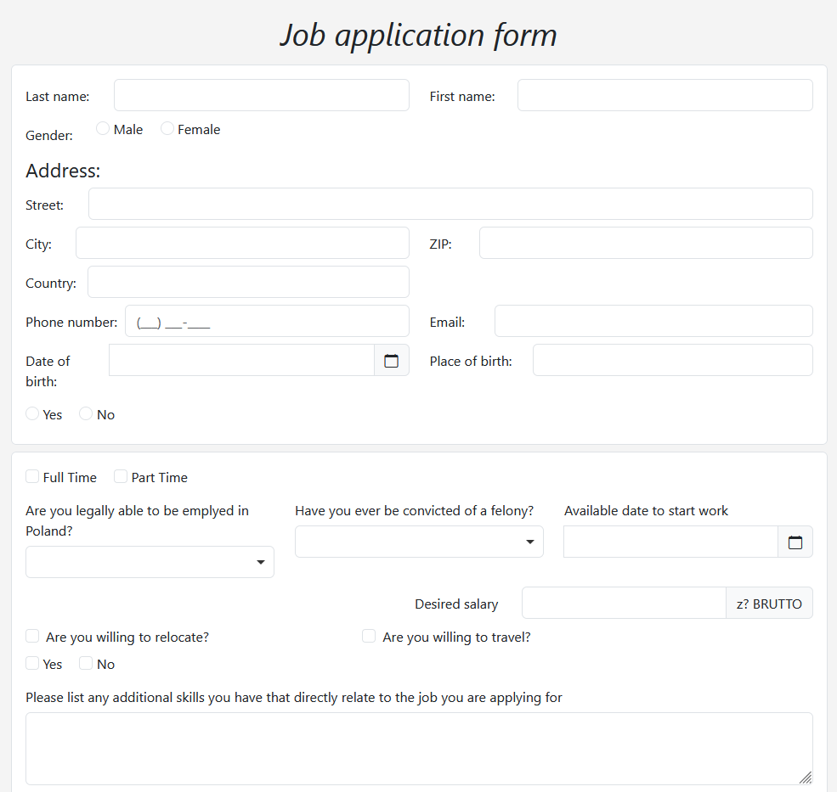
Creating a web form
Form components
The form creator provides everything you need to create nice forms with simple means:
Large choice of components: text, date, email, password, lists, checkboxes, file upload, buttons
Easy arrangement using drag-and-drop
Several layout options as columns, tabs, tables
Extensive usability features: tooltips, descriptions, placeholders, entry masks, prefill with default values, validations
Forms consisting of several pages
Responsive design in the finished form
14

Slide 15
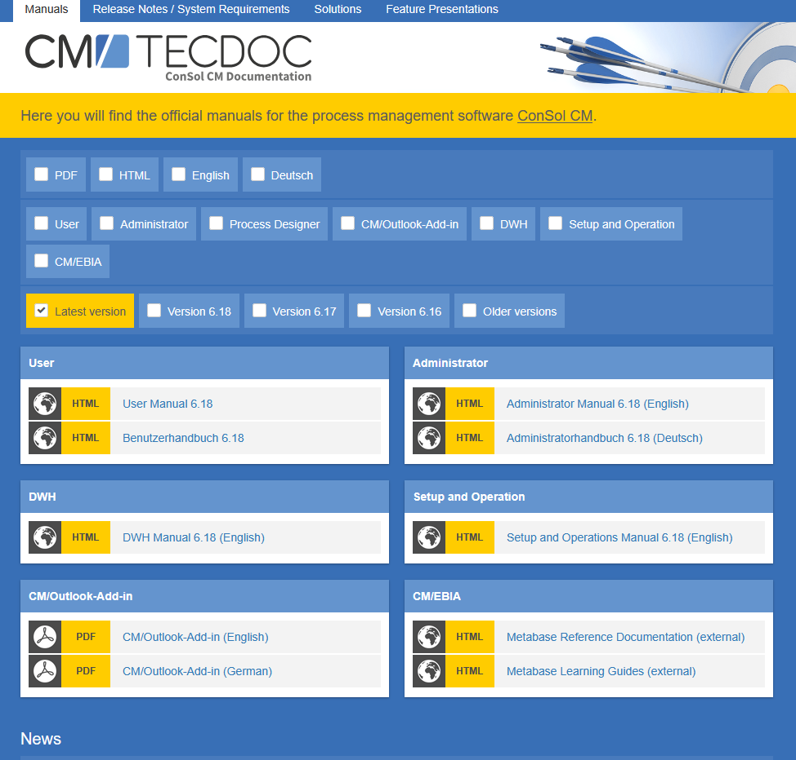
You want to learn more about ConSol CM?
Visit our TecDoc server
You can find:
Manuals
Administrator
User
Release Notes
System Requirements
Feature presentations
Solutions
Discover the new ConSol CM version!

