Slide 1
CM/Machine Learning
December 2022, Product management ConSol CM

Slide 2




Dear ConSol customers, dear ConSol CM customers,
We would like to present you our new ConSol CM add-on CM/Machine Learning, which is available with version 6.13.0. CM/Machine Learning allows you to improve the efficiency of your business processes by automatically classifying your cases. CM/Machine Learning runs locally within your ConSol CM system. No data is transferred to external services. This allows you to use the latest technology and comply with strict data protection regulations at the same time.
Detect the language used in a case and automatically assign the case to the appropriate team.
Detect the mood of the customer and use it to determine the priority and discover trends.
Classify new cases automatically based on the subject, comments and emails.
Please contact us for further information or a live demo.
Your ConSol CM Product management & Sales team
Jan
Zahalka
Engelbert
Tomes
Florian
Fiessmann
Kai
Hinke

Slide 3
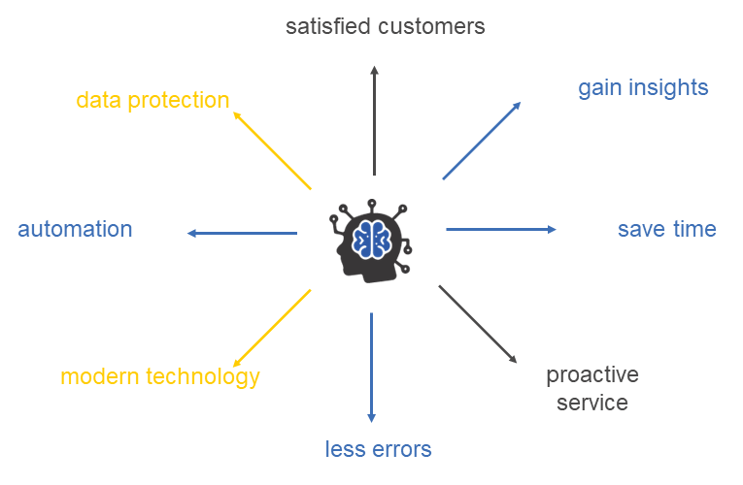
Benefits of machine learning
Take advantage of the benefits of machine learning in ConSol CM
CM/Machine Learning offers features to detect the language and sentiment and classify cases.
Relieve your staff by further automating your processes.
Reduce errors by avoiding manual steps.
Increase the speed of case handling in your processes to improve customer satisfaction.
CM/Machine Learning runs locally within your ConSol CM system. No data is transferred to external services. This allows you to use the latest technology and comply with strict data protection regulations at the same time.
3

Slide 4
Benefits of machine learning
Example: What can you achieve with machine learning in ConSol CM?
Incoming email
Dear support team,
We have a maintenance contract for our two coffee machines (HomeLine 500). Our customer number is C264720015. The monthly cleaning should be done on 15.06. according to the contract. We have an inhouse event this day. Would it be possible to postpone the date by one week?
Best regards
Maria Muster
Office administration
ConSol Software GmbH
Machine learning analysis
Language = English
Sentiment = Neutral
Customer: ConSol Software GmbH
Customer number: C264720015
Affected product = HomeLine 500
Category = Maintenance contract
Request = Appointment change
Routine request = Yes
4

Slide 5
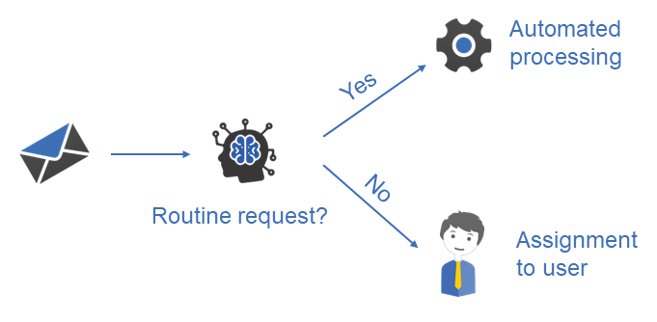
Machine learning in ConSol CM: process automation
Automate the handling of routine requests
CM/Machine Learning allows you to classify incoming emails and detect routine requests. Based on the set category, ConSol CM can determine the kind of customer request and decide whether it is a routine request, as asking for information material or changing an address. Routine requests can be processed automatically in the workflow, so that the team only needs to take care of special cases.
5

Slide 6
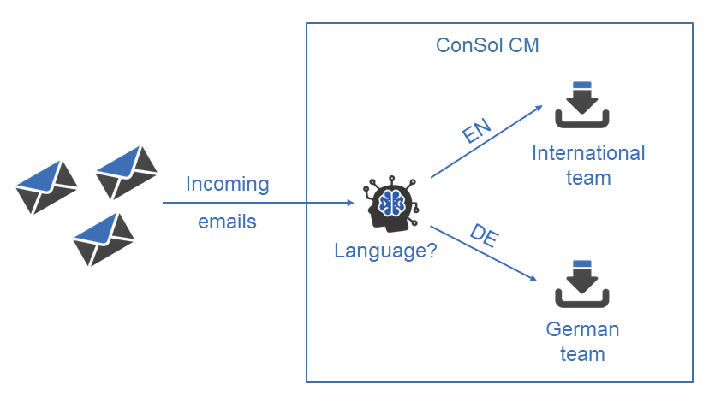
Machine learning in ConSol CM: language detection
Automate your processes and boost efficiency
You take care of customers in several languages?
CM/Machine Learning allows you to avoid complicated configurations and manual steps:
Automatically assign new cases to the right team based on the language. No need to create separate mailboxes.
Send automatic replies in the customer‘s language. The correct template is selected automatically based on the language in which customer communication takes place.
Save time, avoid errors and keep your ConSol CM configuration as simple as possible.
6

Slide 7
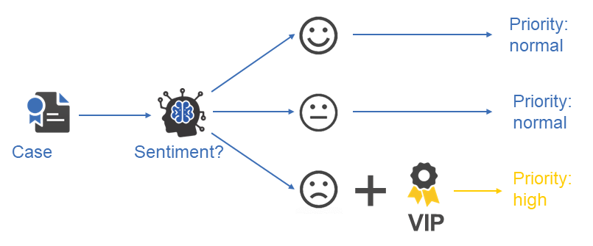
Machine learning in ConSol CM: sentiment detection (1)
Prioritize cases based on the customer‘s sentiment
CM/Machine Learning allows you to detect the mood of a customer based on the case text. You can, for example, set the priority of a case to “high” as soon as you notice a negative sentiment in an important customer. Improve your customer service by responding proactively!
7
Currently, sentiment detection is available in German only. Please contact us if you are interested in support for English!

Slide 8
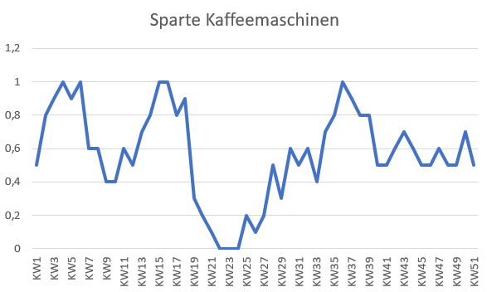
Machine learning in ConSol CM: sentiment detection (2)
Gain insights from the customer sentiment
CM/Machine Learning allows you to measure the trend in the customer sentiment, either globally or by comparing different products or services. Transfer the sentiment detected in the first comment or email to the DWH and calculate a trend curve of the customer sentiment. Gain important insights about the impact of business incidents and decisions on your customers‘ satisfaction.
Started exchange promotion
Problems with the grinder in the new model HomeLine 500
8

Slide 9
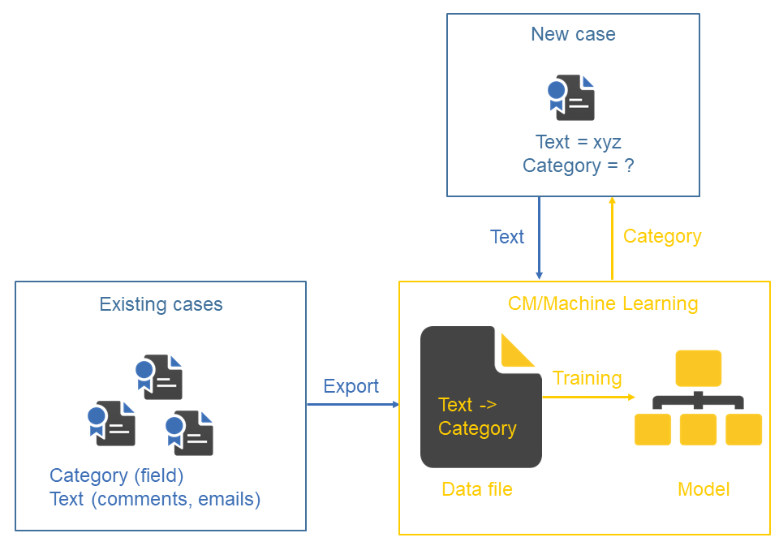
Machine learning in ConSol CM: case classification
Use the full potential of your existing cases
The finished cases in your ConSol CM system constitute a valuable knowledge base.
CM/Machine Learning allows to classify new cases automatically based on the existing cases. You can train a model, which contains the case text and the set category of your existing cases, for this purpose.
Case classification offers a lot of potential for optimization:
Determine the product which a request refers to based on the first comment / email of new cases.
Categorize new cases and directly assign them to the appropriate team.
Detect recurring routine requests and automate their processing.
9

Slide 10
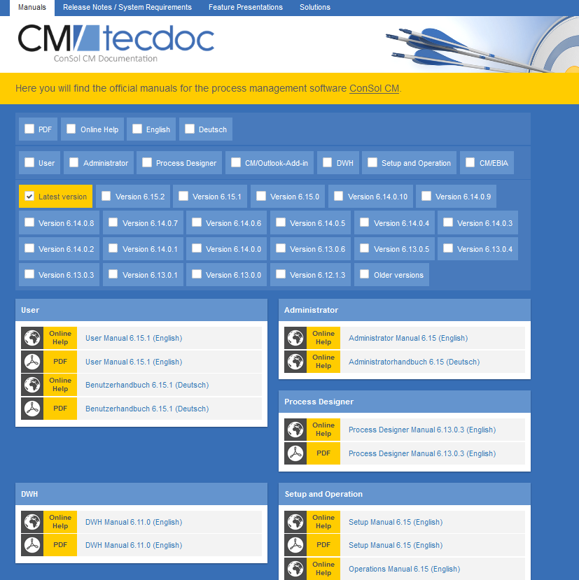
You want to learn more about ConSol CM?
Visit our TecDoc server
You can find:
Manuals
  Administrator
  User
Release Notes
System Requirements
Feature presentations
Solutions
Discover the new ConSol CM version!

