Slide 1
ConSol CM/Resource Pool
Integrate and manage additional objects
December 2022, Product management ConSol CM

Slide 2




Dear ConSol customers, dear ConSol CM customers,
We would here like to inform you about CM/Resource Pool, a ConSol CM add-on which allows you to add new object types to your ConSol CM database. Manage, for example, IT assets, contracts, products and / or pieces of information. Link the resource pool objects to cases, contacts and companies, thereby establishing a complete network of the objects you deal with in your every day business processes.
Use manual and automatic resource activities to fully integrate resources in your business processes.
In this way, you can speed up your service processes, bundle information and improve your customer service.
Please contact us for further information or a live demo.
Your ConSol CM Product Management & Sales Team
Jan Zahalka
Engelbert Tomes
Florian Fiessmann
Kai Hinke

Slide 3
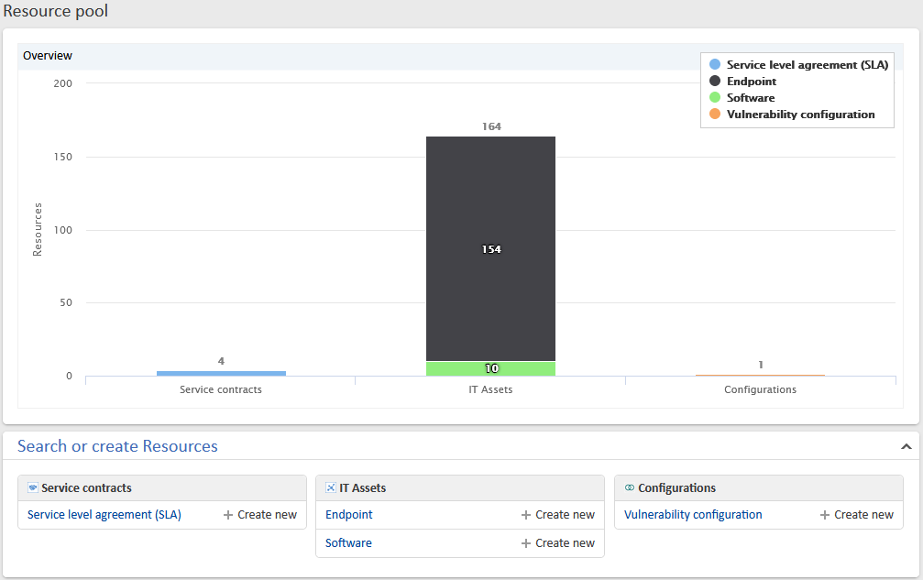
CM/Resource Pool
Overview
Functions
Use cases

Slide 4




Overview about CM/Resource Pool
Integrate additional objects
Manage your resources with CM/Resource Pool and include them in your processes. You can define any number of objects as resource types. Once this is done, you can create resources in the corresponding resource types.
CM/Resource Pool is the ideal solution for managing various different assets, for example:
Licenses or contracts (e.g. SLAs)
Software products
Hardware products (e.g. PC, printers, servers)
Buildings

Slide 5
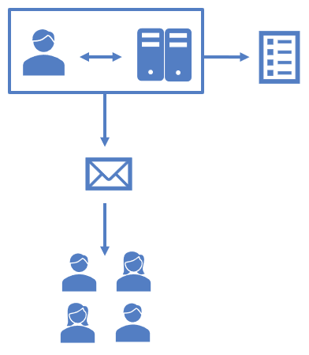
Functions of CM/Resource Pool
Ideal overview with relations
In CM/Resource Pool, it is possible to link resources with each other, as well as to contacts and cases.
Get a quick overview about the connections.
Speed up your process time and increase productivity and customer satisfaction.
Example:
A contact reports a server failure. Because of the relations in the CM system, you can immediately see which other contacts are affected by that failure. You inform the affected contacts immediately and coordinate the solution process.

Slide 6
Functions of CM/Resource Pool
Appealing dashboard
In the Web Client, the resources are shown on a practical dashboard:
Overview of defined resource categories and types
Bar charts showing the number of resources for each resource type
Convenient links for opening resource lists and creating new resources

Slide 7
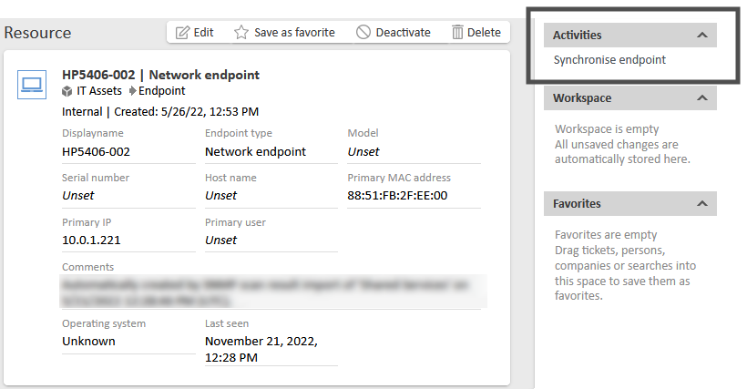
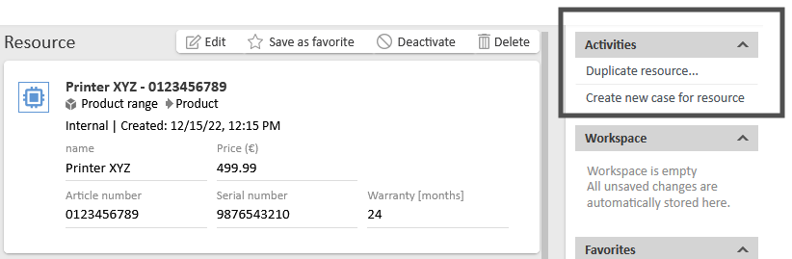
Functions of CM/Resource Pool
Potential for further automation
With resource activities, you can add manual and automatic process steps to your resources, for example:
Synchronize devices
Create cases directly for affected resources
Send notifications to the responsible users
Adjust SLAs when a contract has changed
Resource activities can be completely personalized to your individual work with resources.

Slide 8
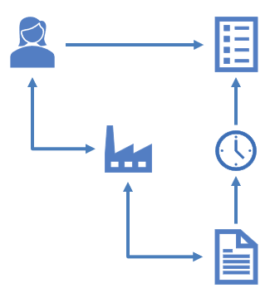
Use cases for CM/Resource Pool
SLA management
Your contracts with your customers include specific solution times for cases. CM/Resource Pool allows you to easily manage the agreed solution times and link them to the cases:
A customer creates a new case.
The related company will be selected automatically.
The SLA contract with the company will be analyzed and the reaction time for the new case will be set based on the SLA.

Slide 9
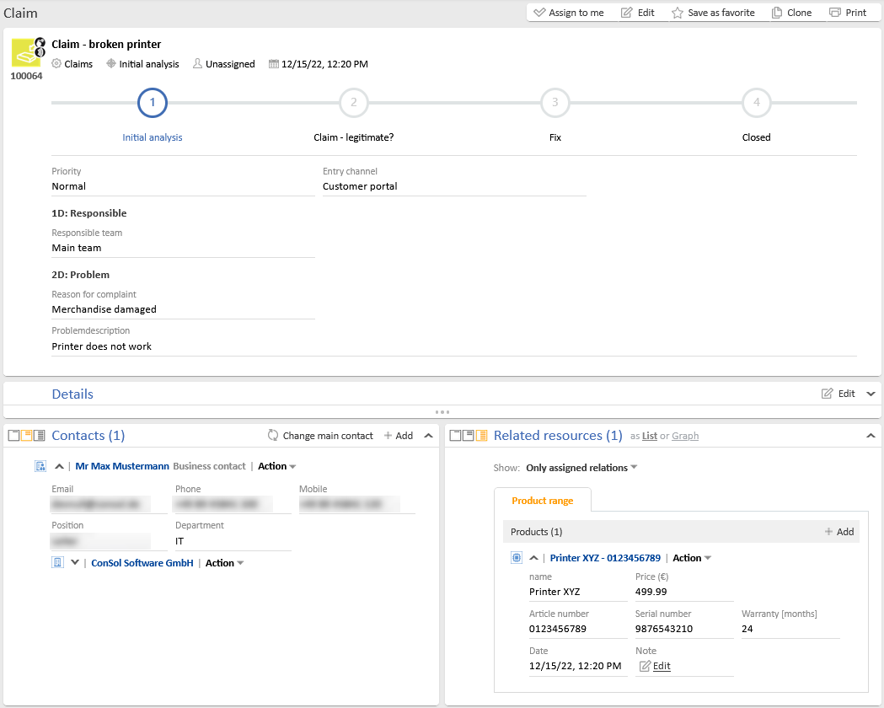
Use cases for CM/Resource Pool
Products for complaints
You have a complaint process, which can affect different products. Link the affected products to the case. In this way, the user in the Web Client gets all relevant product information for the case immediately. No time-consuming research is necessary.

Slide 10
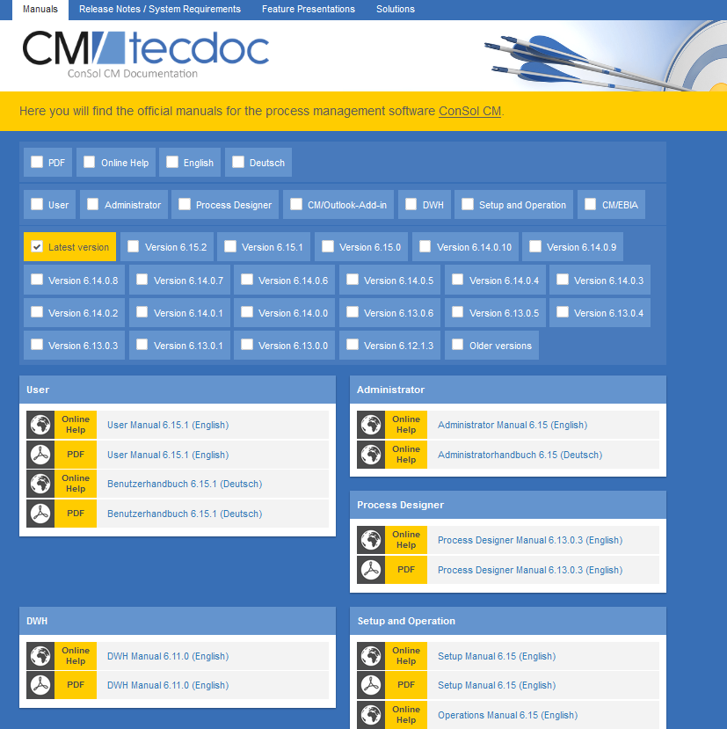
You want to learn more about ConSol CM?
Visit our TecDoc server
You can find:
Manuals
Administrator
User
Release Notes
System Requirements
Feature presentations
Solutions
Discover the new ConSol CM version!

