Slide 1
ConSol CM/Track
The ConSol CM customer portal
June 2025, Product management, ConSol CM

Slide 2




Dear ConSol and ConSol CM customers,
we would like to present the customer portal CM/Track, a ConSol CM add-on that provides access to cases for your customers.
Your customers can log in and see the current status of all their cases. They can open a new case, ask questions, or attach additional documents. If configured, they can even move the case to the next step in the business process and provide additional information using forms.
In this way, you can improve your service for external and internal customers, provide an asynchronous method of customer communication and reduce the number of shorter customer calls. Your service team can focus on expert customer communication thus further improving the quality of service.
Enjoy reading this presentation. Please call us, should you want to know more about CM/Track: +49-89-45841-120
Your ConSol CM Product management & Sales team
Johanna
Juszak
Engelbert
Tomes
Florian
Fiessmann
Kai
Hinke

Slide 3
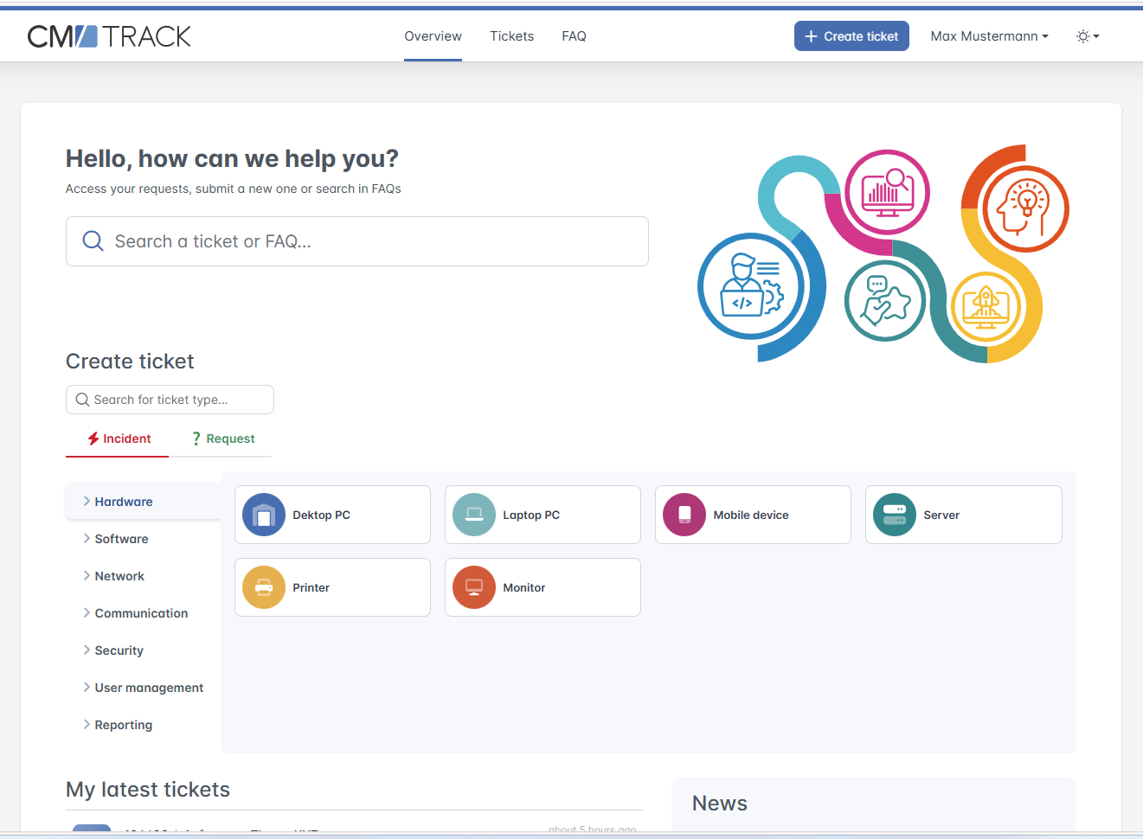
CM/Track
Advantages
Features
Technical background

Slide 4
Advantages of CM/Track as a customer portal
Communicate with your customers via CM/Track
Proactive customer communication
Use FAQs and news to publish important information for your customers to reduce the number of created cases.
Close involvement of the customers in the business process
Integrate your customers into the processing of their requests by using workflow activities and forms to speed up work on the cases.
Numerous use cases
CM/Track can be used both for internal and external customers. For example:
  Internal: IT helpdesk and service desk, procurement processes (LDAP integration is possible)
  External: customer, reseller and partner portals

Slide 5
Features of CM/Track – start page
Start page with everything your customers need
The new start page of CM/Track is intuitive and easy to use. Your customers can take advantage of several features:
Direct case creation in specific queues
Search feature covering all cases of the user and the FAQs
News feature
Use the extensive configuration options regarding the layout and content of the start page:
Determine the GUI texts
Define your own tiles for various application areas.
Set the color and displayed information for the news entries
5

Slide 6
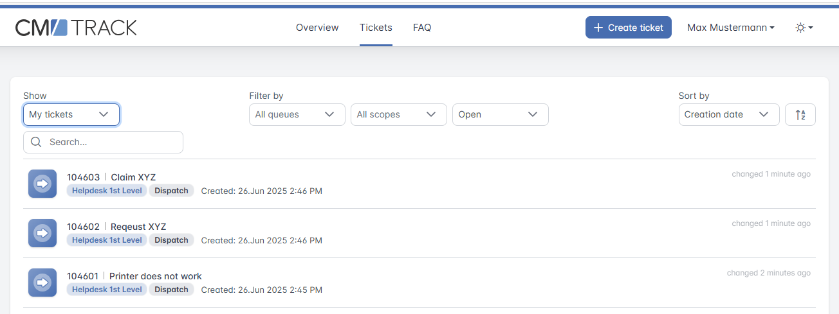
Features of CM/Track – case list
Keep an overview of all cases
The case list shows all the cases of the user. The processing status (scope) and the basic data, such as subject, queue and creation date, are directly visible. In addition, the case list provides the following features:
Display the cases of the user or all cases of the user‘s
company
Search for cases
Filter by queue and status (open / closed)
Sort by different criteria
The user can click a case to see its details.
6

Slide 7
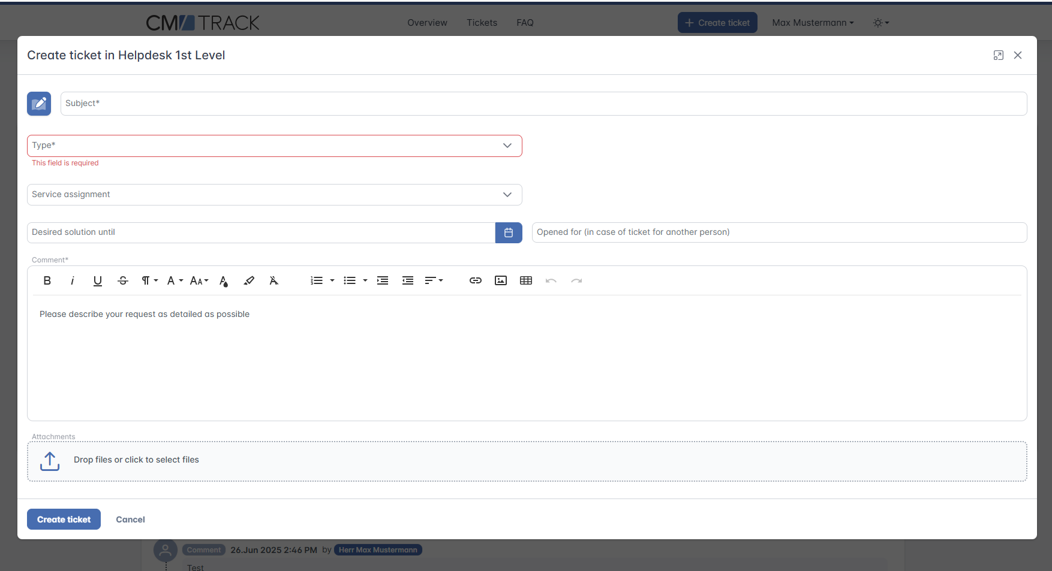
Features of CM/Track – case creation
Allow your customers to open cases
Give your customers the opportunity to create cases on their own. This way, you can save time because, instead of an email or phone call, you directly receive a case with all the required data.
You define the queues in which the customers can create cases and the fields which they need to fill out.
Your customers enter the respective data and write a comment.
Optionally, your customers can attach additional documents.
You can then work on the cases as usual in the Web Client.
7

Slide 8
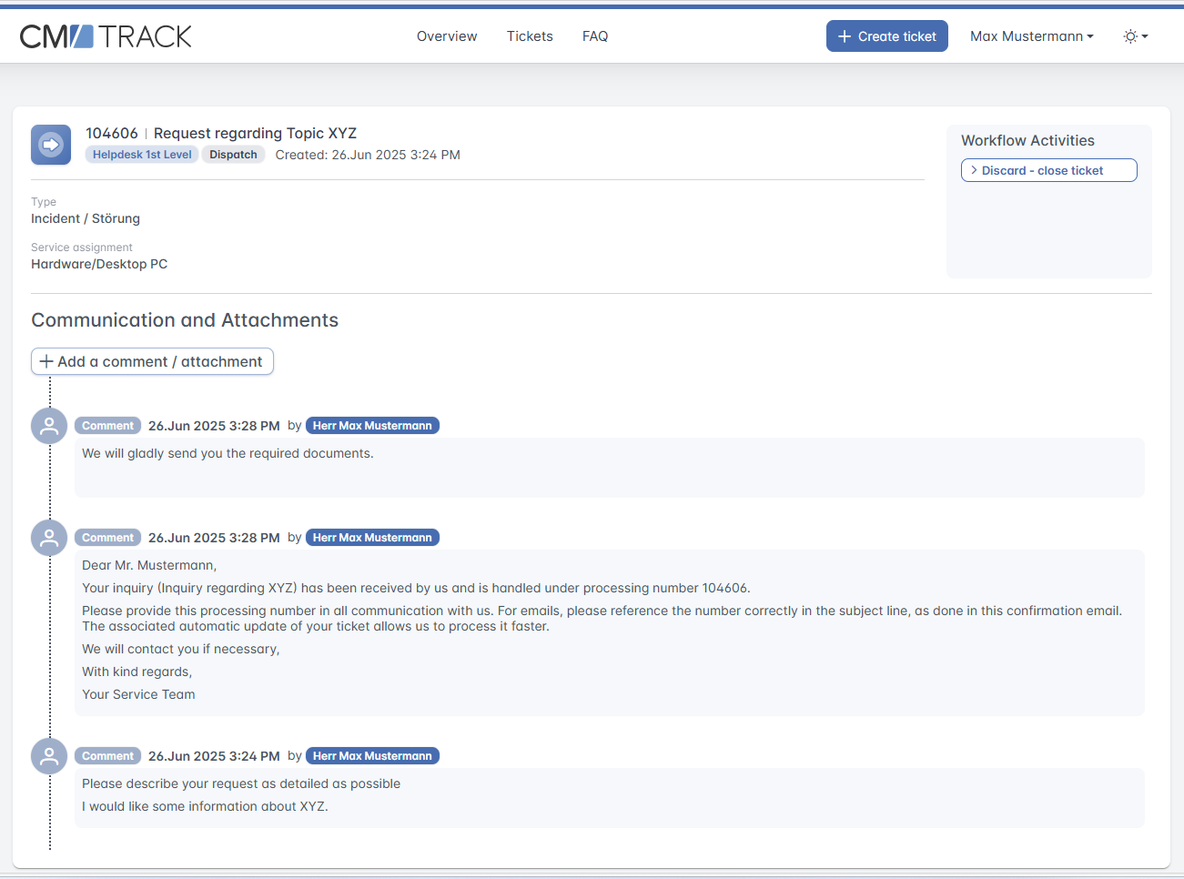
Features of CM/Track – case details
Allow your customers to track their cases
Your users see the current processing status of a case in the case details. This way, your customers can obtain information about their requests in a convenient way at any time. The following information is displayed:
Comments
Emails
Fields filled by the engineer
The engineer in the Web Client decides which comments and emails should be shown in CM/Track.
In addition, the customer can add comments and attachments, which are then displayed in the Web Client.
8

Slide 9
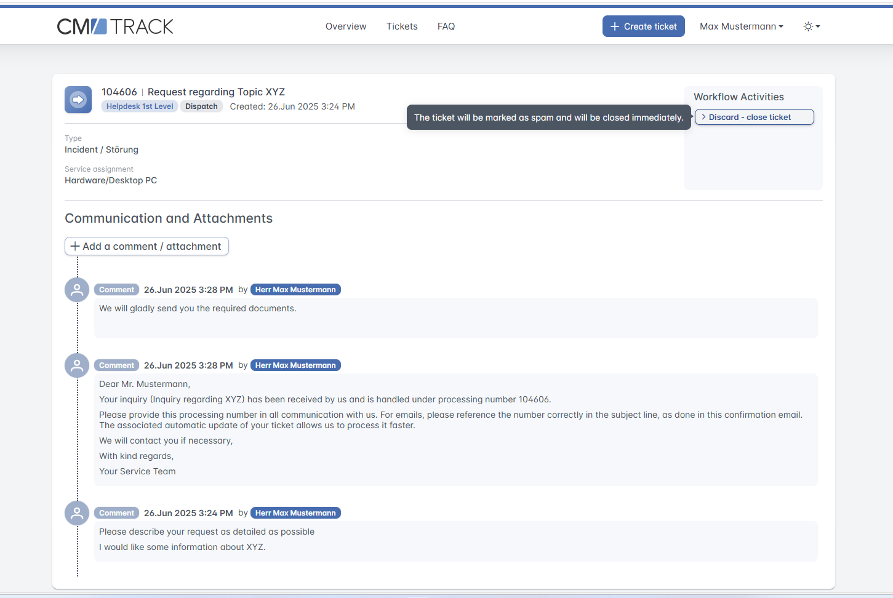
Features of CM/Track – workflow activities
Use additional features to interact with the customers
CM/Track provides workflow activities that the customers can click to move their cases to the next step in the business process. They can fill forms with data which is needed in the course of the process.
This new option to interact with customers, in addition to emails and comments, allows you to speed up case processing and improve customer satisfaction.
9

Slide 10
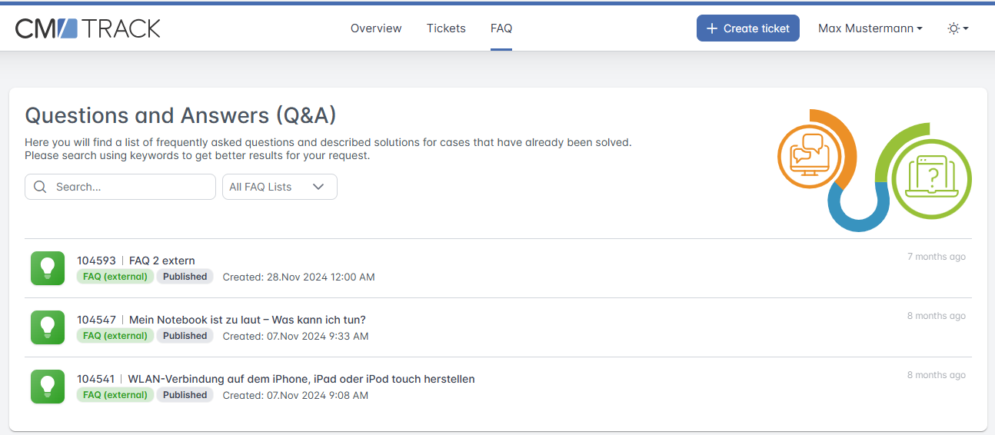
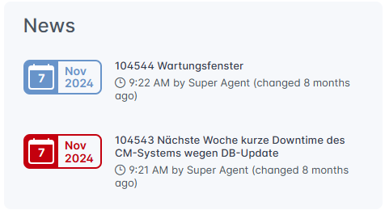
Features of CM/Track – FAQs and news
Communicate proactively with your customers by using FAQs and news
Use the news feature to place important information directly on the start page. Ideal for general information and announcements.
Create FAQs with solutions for frequently occurring problems and collect answers to common questions. Ideal for instructions and support.
Avoid the situation that several customers create cases about the same problem and support your customers in solving problems on their own.
10

Slide 11
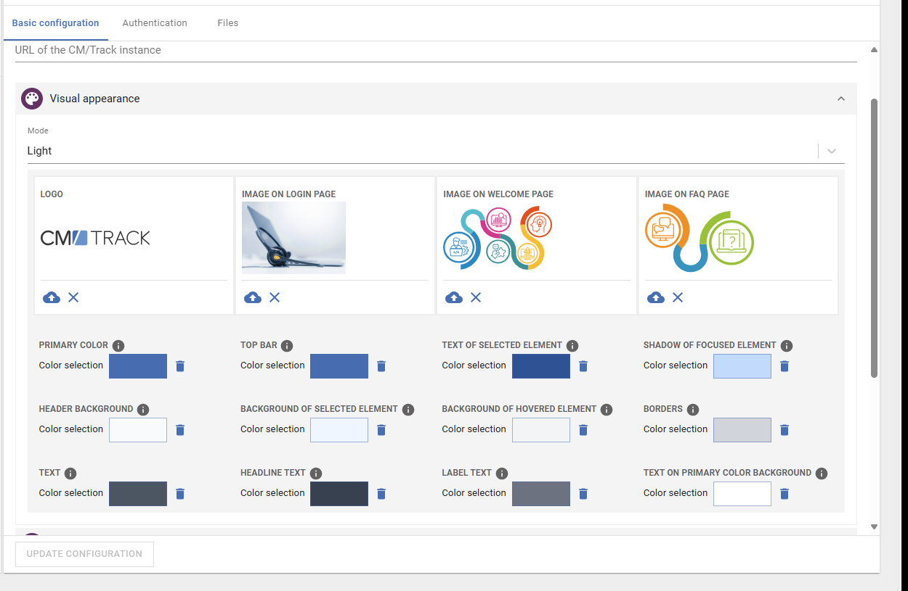
Features of CM/Track – start page
Simple configuration through the Web Admin Suite
With the help of the Web Admin Suite, you can easily adapt CM/Track to your own purposes. For example, the following can be changed with a mouse click:
Integrate your own logos and images
Change colors
Customize widgets on the homepage
With the HTML widget, you can display any content on the homepage.

Slide 12
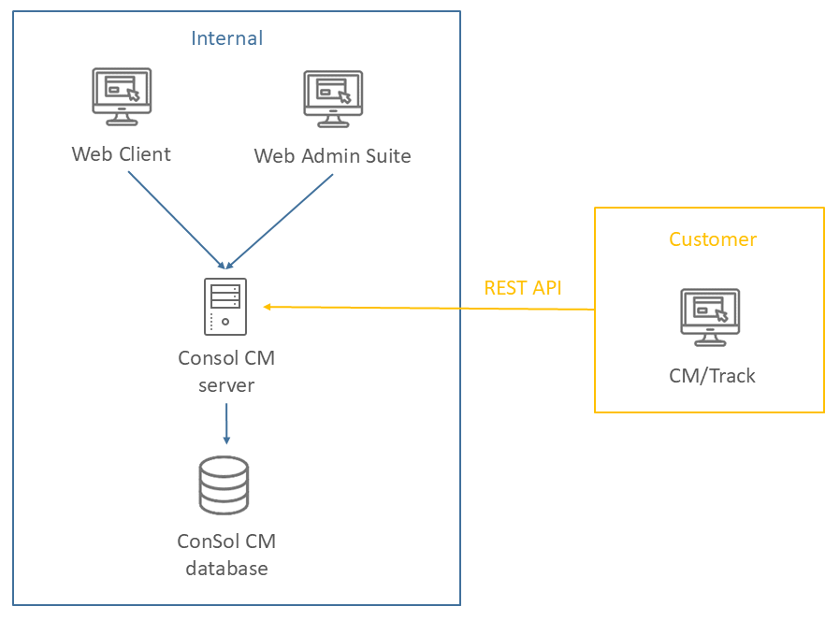
Technical background of CM/Track
Technical key data about CM/Track
All pages and entry masks of the modern web-based application have a responsive design and automatically adapt to the screen size.
CM/Track can be used on PCs, laptops, tablets and mobile phones.
The communication with the ConSol CM server is done via REST API.
CM/Track includes an integrated proxy and can be deployed independently of the ConSol CM server. Thus, it meets the security requirements for external provision.

Slide 13
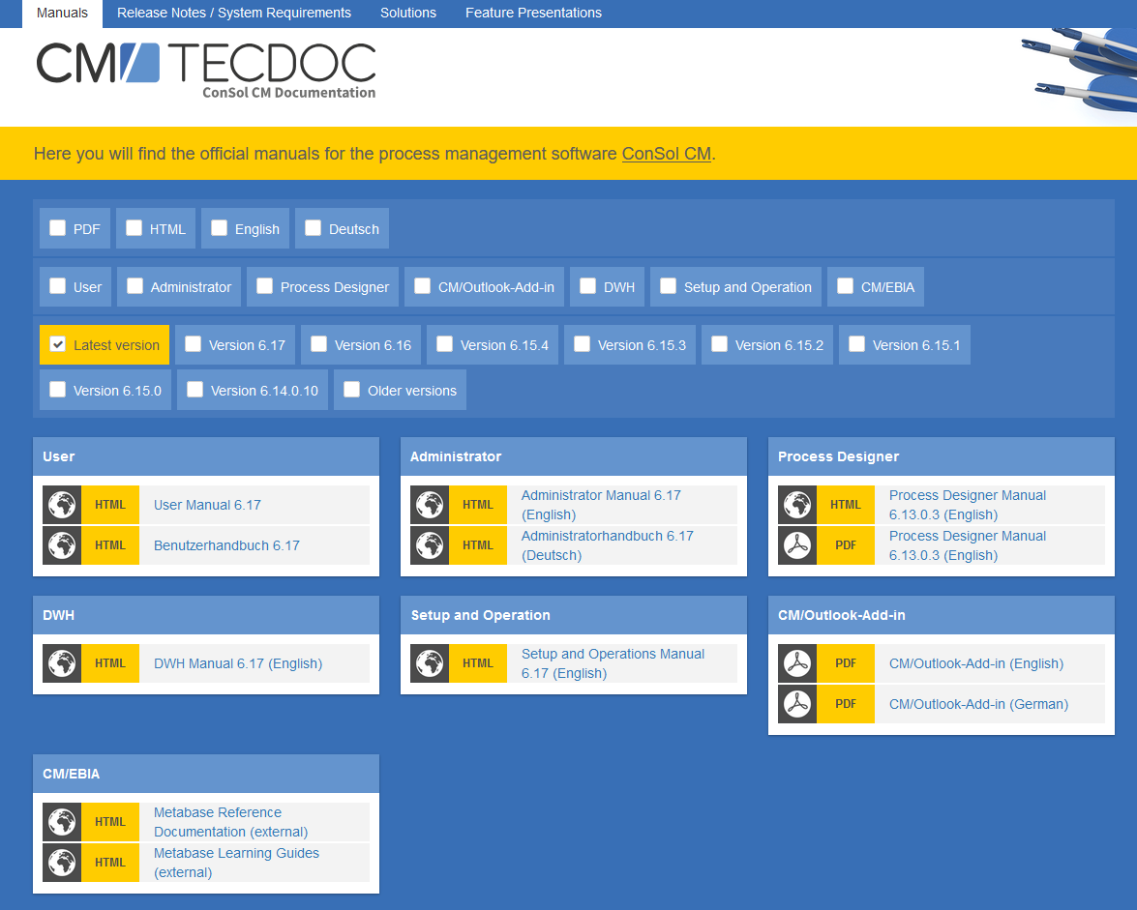
You want to learn more about ConSol CM?
Visit our TecDoc server
You can find:
Manuals
  Administrator
  User
Release Notes
System Requirements
Feature presentations
Solutions
Discover the new ConSol CM version!

